Slide 1
My Own Career & Education Path
Created by: Samantha Godshall

Slide 2

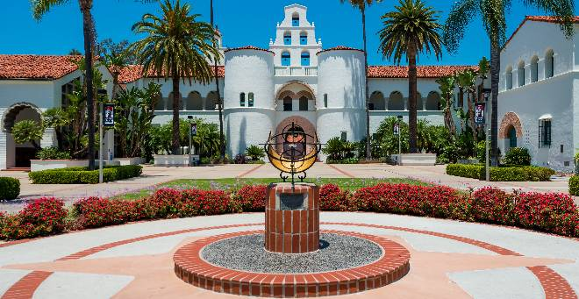
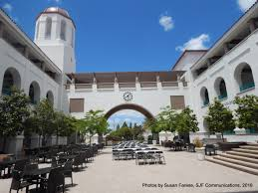
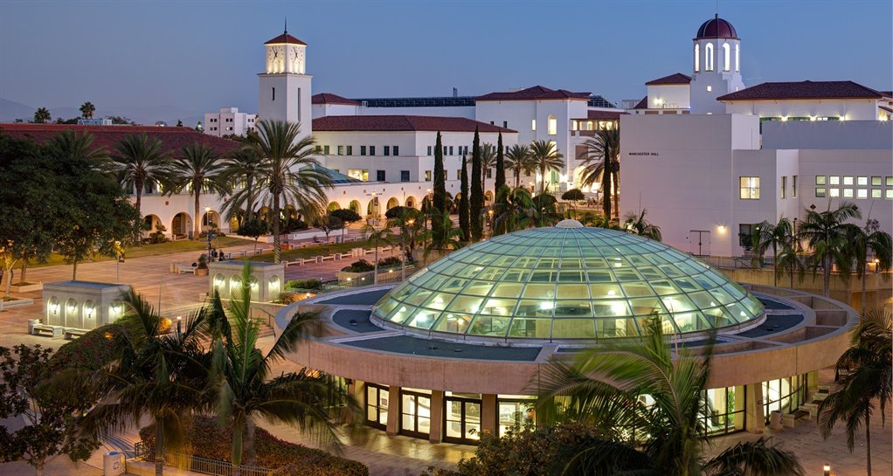
Required Education
Opportunities in Education
This would be a public school. The school I would go to would be SDSU.
Requirements –the required GPA is a 2.9, the total population is around 34,000, only an estimated 23% attend SDSU, 4,488$ is the cost per semester, a FAFSA application is required, many apply through ucmentor.com, average SAT score is 1174, average ACT score is 27.

Slide 3



Chosen Major
Law and criminal justice
The graduation rate is
I would still live at my own house as opposed to living on campus
I could work as…
An FBI agent
Judge
Probation Officer
Forensic Science Technician
Fish and Game Warden
Private Detective

Slide 4



Requirements
All FBI Special Agents must qualify for at least one of the five FBI Special Agent Entry Programs to be eligible for employment
must be at least 21
meet specific educational and experience requirements
complete a twelve-week Uniformed Police Training Program at the Federal Law Enforcement Training Center (FLETC) in Glynco, Georgia

Slide 5


Hiring Companies in my Major
$18.76 an hour
Entry Level Special Agents
Bachelor’s degree in Criminology, Criminal Justice, Homeland Security, History, Sociology, Psychology, or other related field, or 4+ years of law enforcement or military experience.
able to obtain a U.S. Government Security Clearance
$23.68 - $28.59 an hour

Slide 6

Merito Group | San Diego County
Entry level special agent | Police recruit
to protect the American people | maintain peace and order
Physically and mentally capable | Physically and mentally capable
Bachelors degree | Bachelors degree
yes/yes | yes/yes
81,042.2 | 13,508.8
1.5 hour estimated drive | 2 hour estimated drive

Slide 7
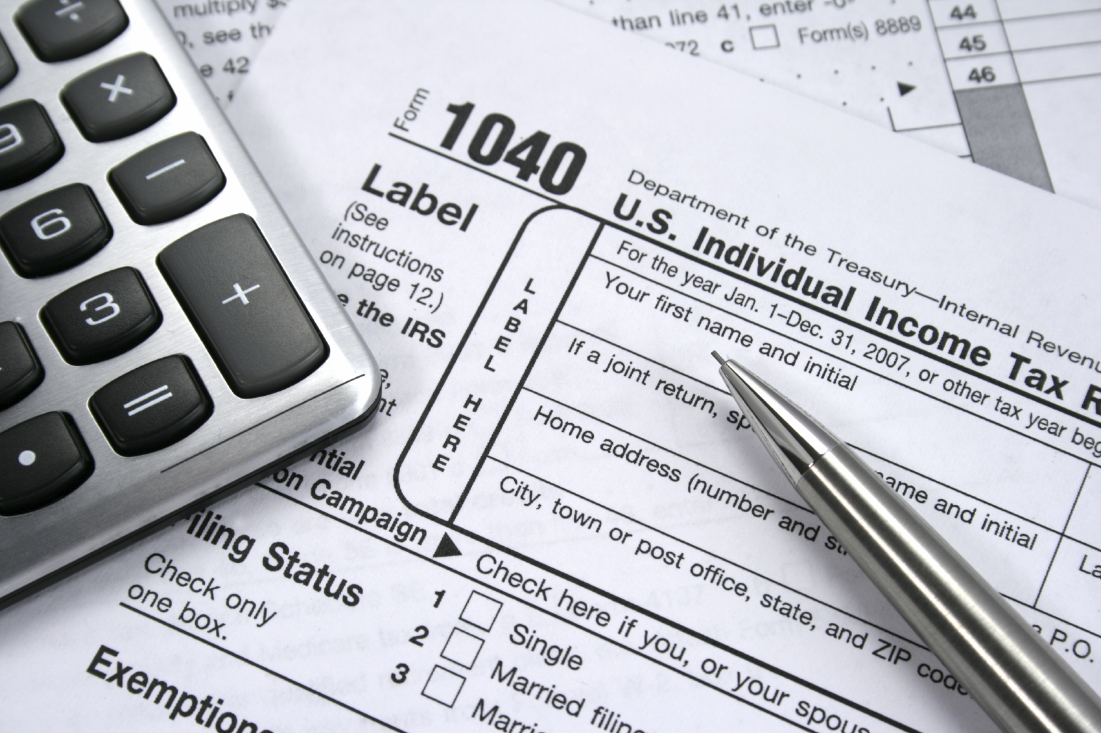

Career & lifestyle
$4,253 a month, and budgeted $2,921 towards expenses. This will leave me $1,333 a month.
4,253
An apartment. $1,249
Used 2016 Hyundai Accent SE
$10994. $220
$40
$70
$982
$20
25% of what I spend

